Slide 1

Law of the Weakest Link:
Cross Capabilities of Large Language Models
Aston Zhang
Llama Team, Meta Generative AI
Joint work with M. Zhong, X. Wang, R. Hou, W. Xiong, C. Zhu, Z. Chen, L. Tan, C. Bi, M. Lewis, S. Popuri, S. Narang, M. Kambadur, D. Mahajan, S. Edunov, J. Han, and L. van der Maaten

Slide 2
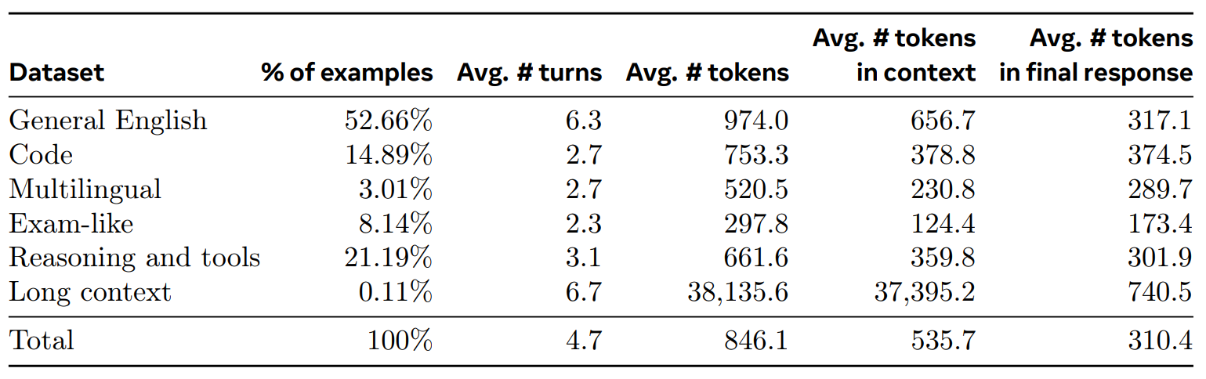
Background: Development of LLMs
Development of LLMs heavily focuses on individual capabilities
Data Mix + Supervised Fine-tuning
For example, data for post-training for Llama 3 is:
Llama Team. The Llama 3 Herd of Models. 2024 Preprint.

Slide 3
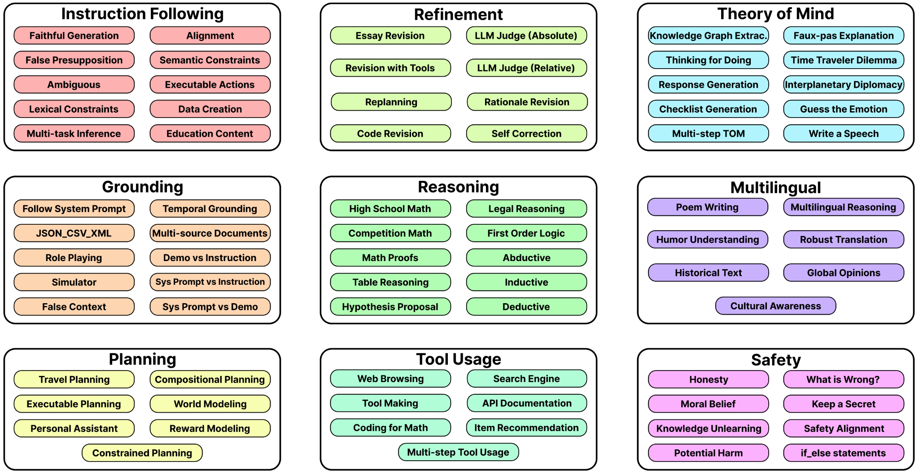
Background: Evaluation of LLMs
Evaluation of LLMs focuses on individual capabilities
Kim et al. The BIGGEN BENCH: A Principled Benchmark for Fine-grained Evaluation of Language Models with Language Models. 2024 Preprint.

Slide 4
Motivation: Lack of Cross-Capability Exploration
Many Real-World Tasks Require Cross Capabilities!!
Examples
Tool Use & Reasoning
Which direction has the total rainfall in Tokyo Japan been trending in the past 10 years? Explain it step by step
Long Context & Coding
Give me a basic understanding of what this web app does. I've provided all the HTML and some JS for the api data
Definition
We define these scenarios as cross capabilities
The intersection of multiple distinct capabilities across different types of expertise necessary to address complex, real-world tasks

Slide 5
Outline
RQ Ⅰ: How can we comprehensively define individual and cross capabilities in LLMs?
RQ II: How can we benchmark both individual and cross capabilities in LLMs?
RQ III: What patterns exist in the relationship between individual and cross-capability performance in LLMs?
RQ IV: How do performance shifts in individual capabilities impact cross-capability performance in LLMs?

Slide 6
RQ Ⅰ
How can we comprehensively define individual and cross capabilities in LLMs?

Slide 7
Individual & Cross Capabilities
7 Single Capability
English
Coding
Reasoning
Image Recognition
Tool Use
Long Context
Multilingual (Spanish)
7 Cross Capability
Coding & Reasoning
Image Recognition & Reasoning
Long Context & Coding
Tool Use & Reasoning
Tool Use & Coding
Spanish & Reasoning
Spanish & Image Recognition
Notes:
\

Slide 8
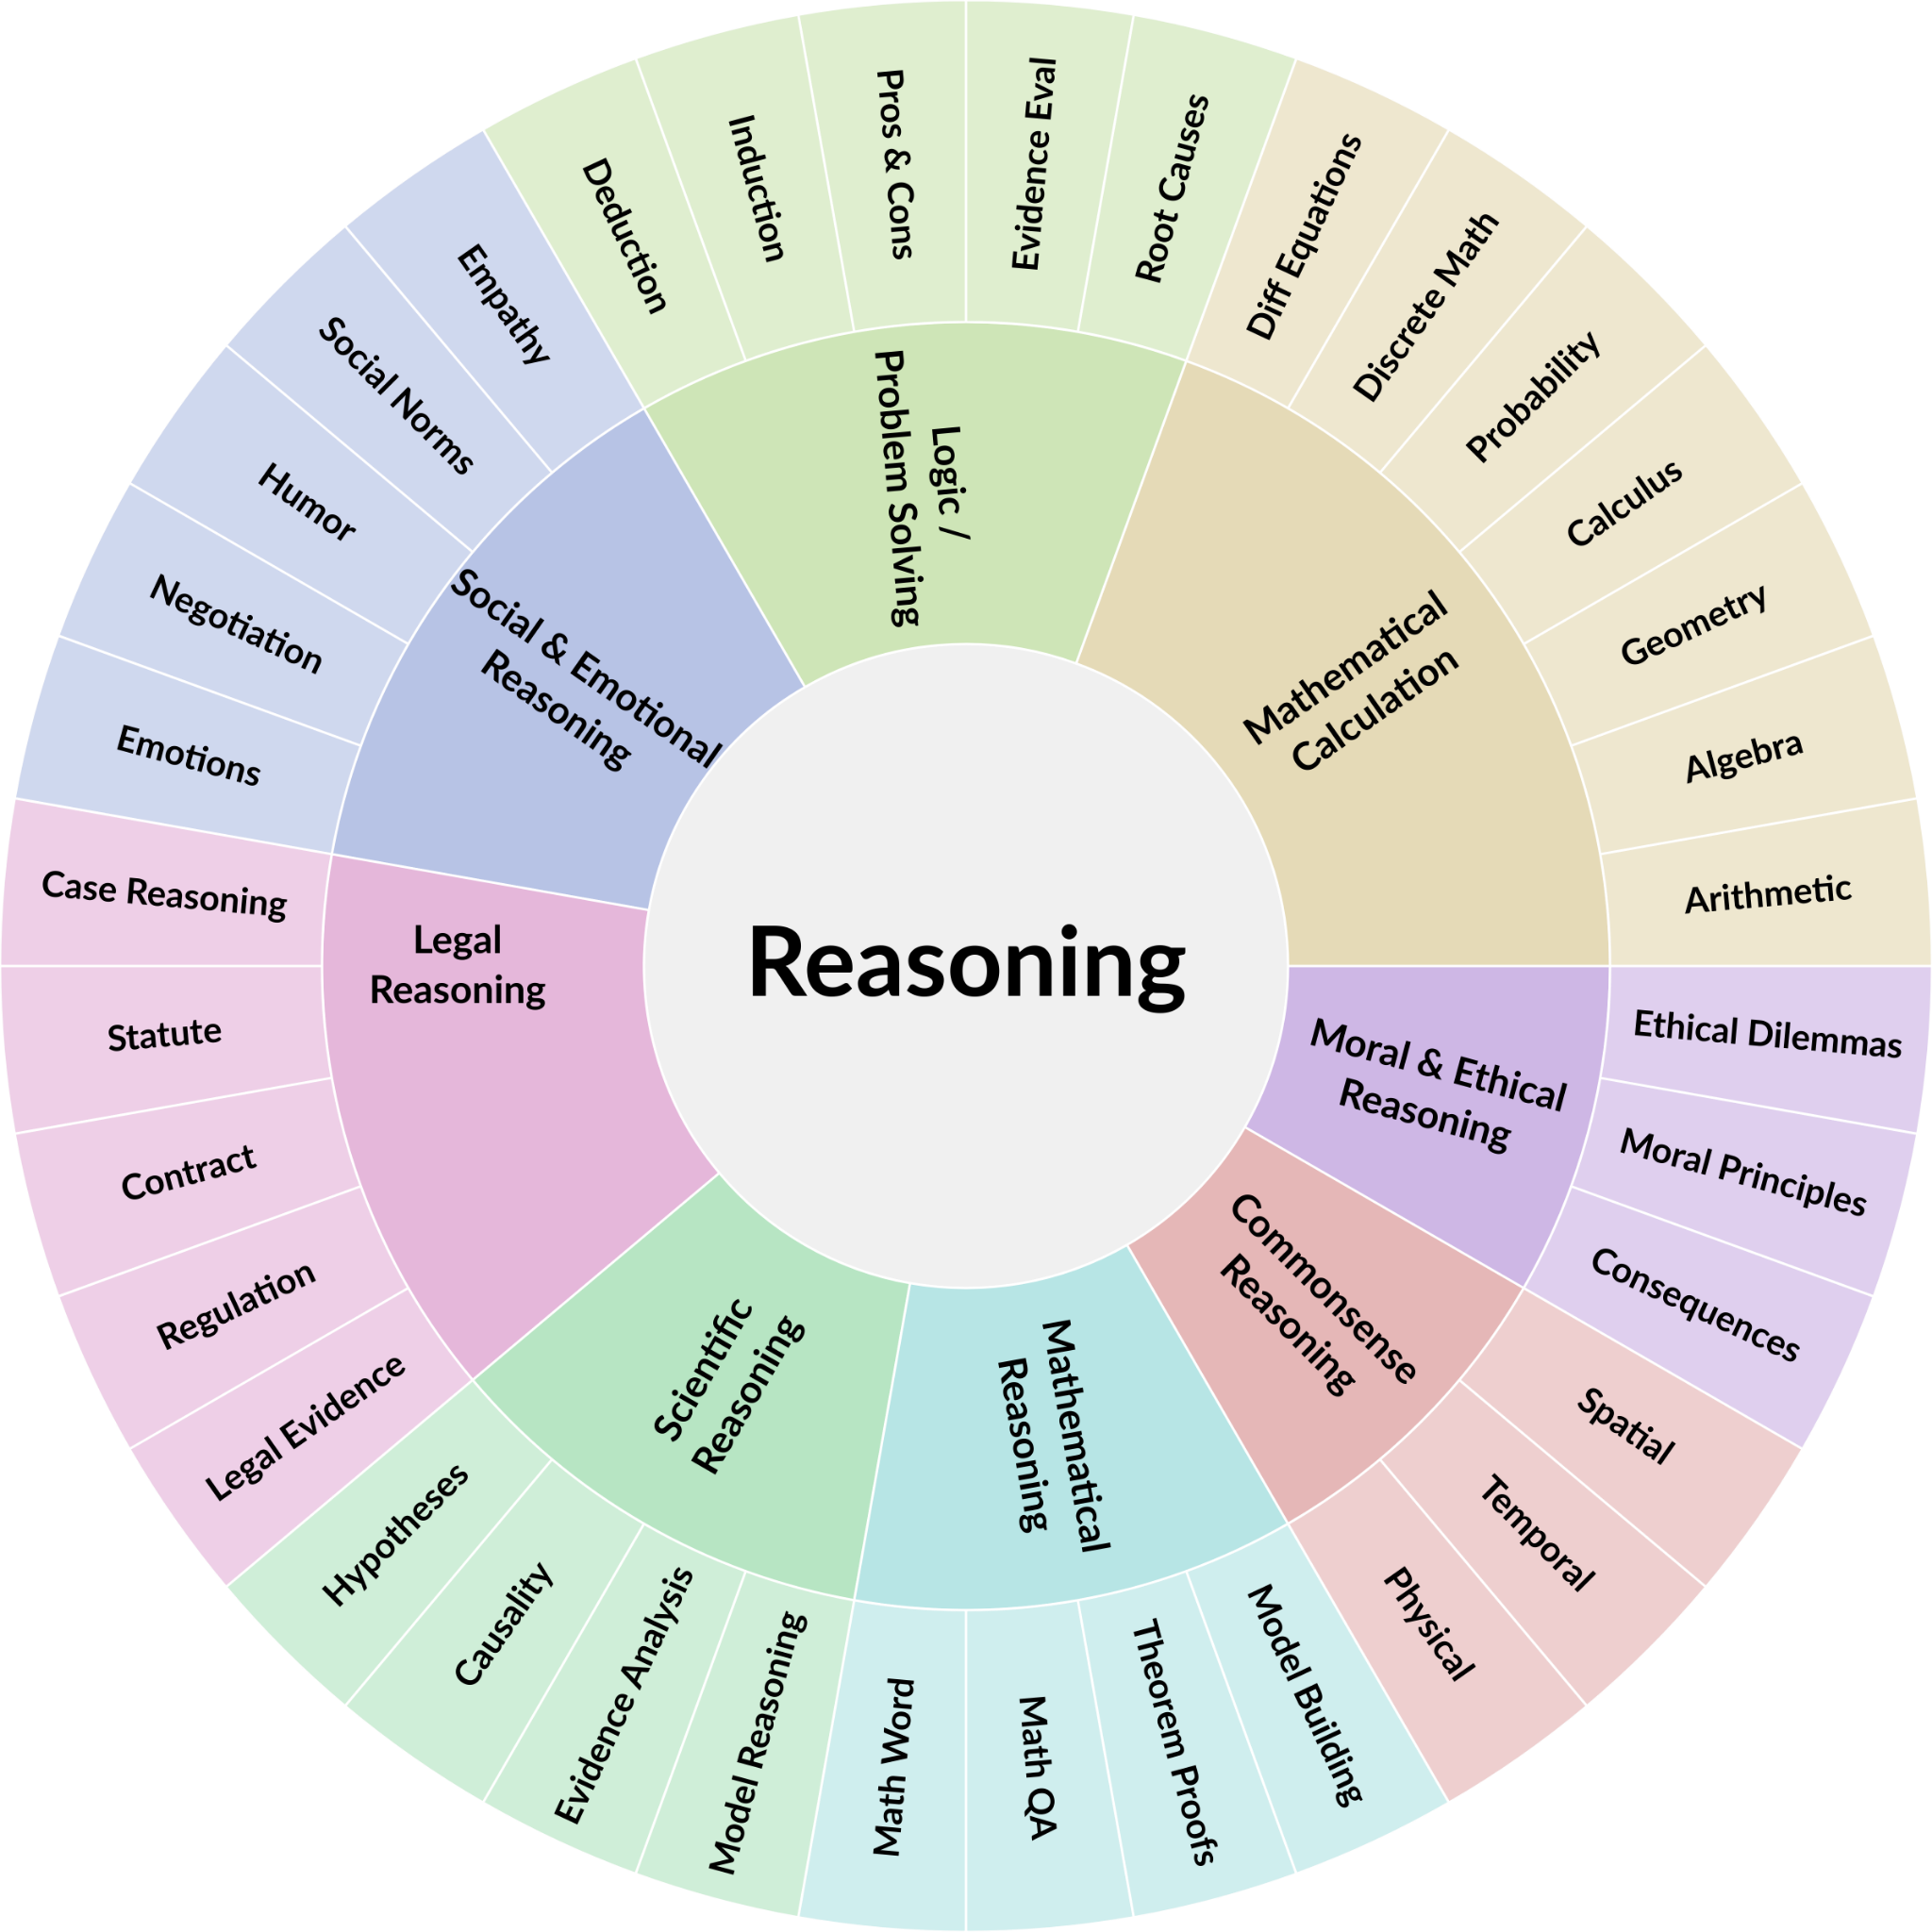
Taxonomy for Reasoning
7 Single Capabilities
English
Coding
Reasoning
Image Recognition
Tool Use
Long Context
Spanish

Slide 9
Examples for Reasoning
Math Reasoning
Jane won the lottery and decided to spend some of the money. She spent $1.50 on the first day. She spent $3 on the second day. She spent $4.50 on the third day. She kept spending her winnings in the same pattern and then on the last day, she spent her remaining $300. How much did she win in the lottery?
Social and Emotional Reasoning
Two chemists are sitting at a bar. The first chemist tells the bartender, “I’ll have some H2O.” The second chemist tells the bartender, “I will also have some water”. The first chemist tells the second chemist, “darn my murder plot failed”. Please explain this joke to me

Slide 10
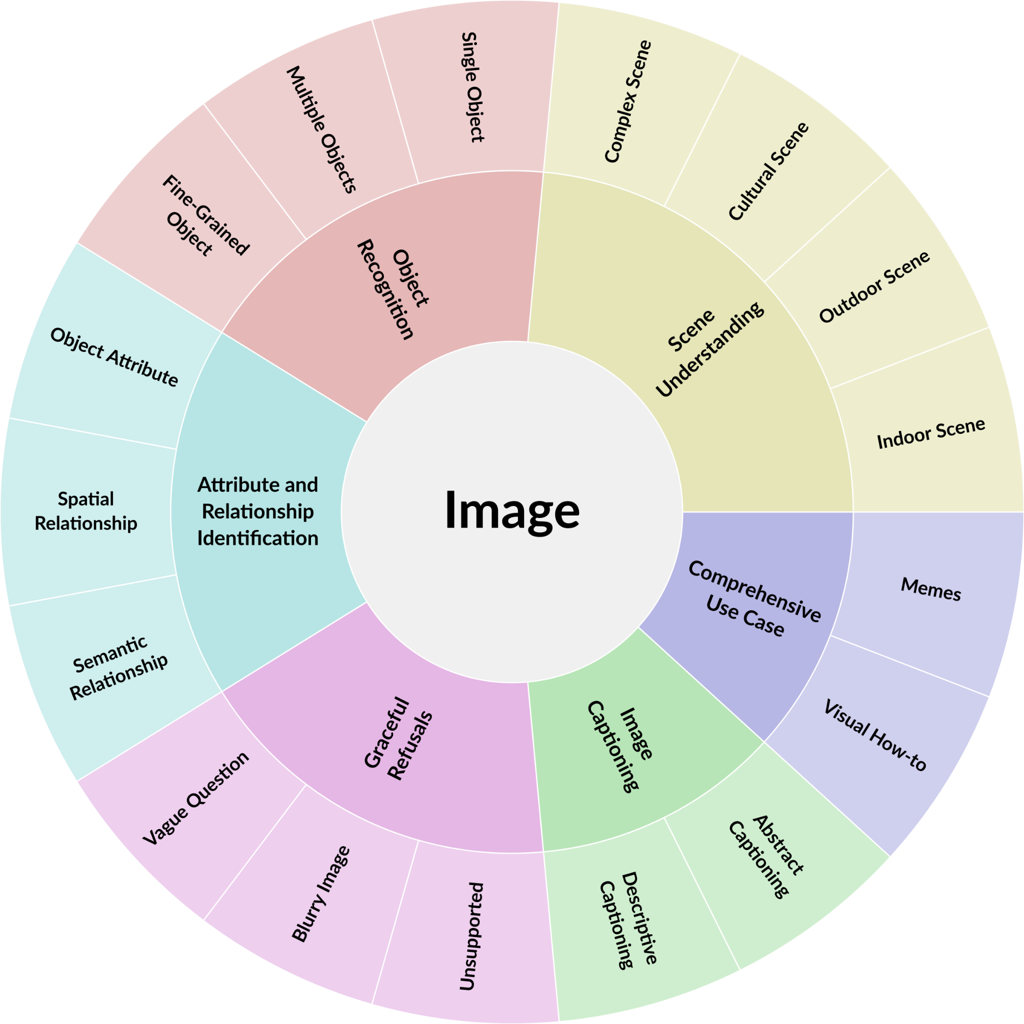
Taxonomy for Image Recognition
7 Single Capabilities
English
Coding
Reasoning
Image Recognition
Tool Use
Long Context
Spanish

Slide 11


Examples for Image Recognition
Object Recognition
How many of these dogs have floppy ears? How many of the floppy-eared dogs have black fur?
Comprehensive Use Case
My bike is not ridable. What does it need to be fixed and how do I fix it?

Slide 12
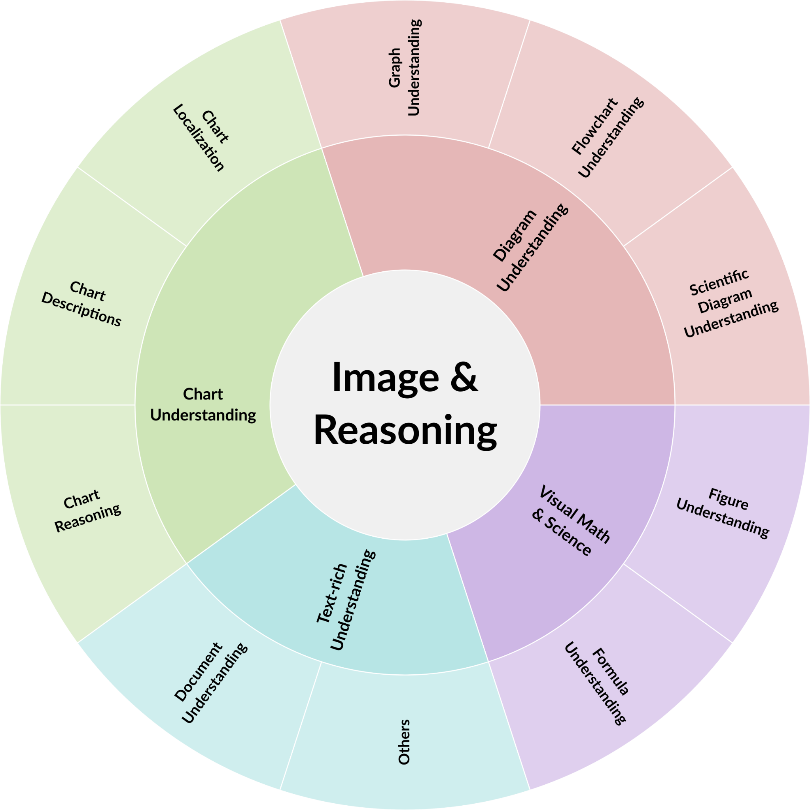
Taxonomy for Image Recognition & Reasoning
7 Cross Capabilities
Coding & Reasoning
Image Recognition & Reasoning
Long Context & Coding
Tool Use & Reasoning
Tool Use & Coding
Spanish & Reasoning
Spanish & Image

Slide 13
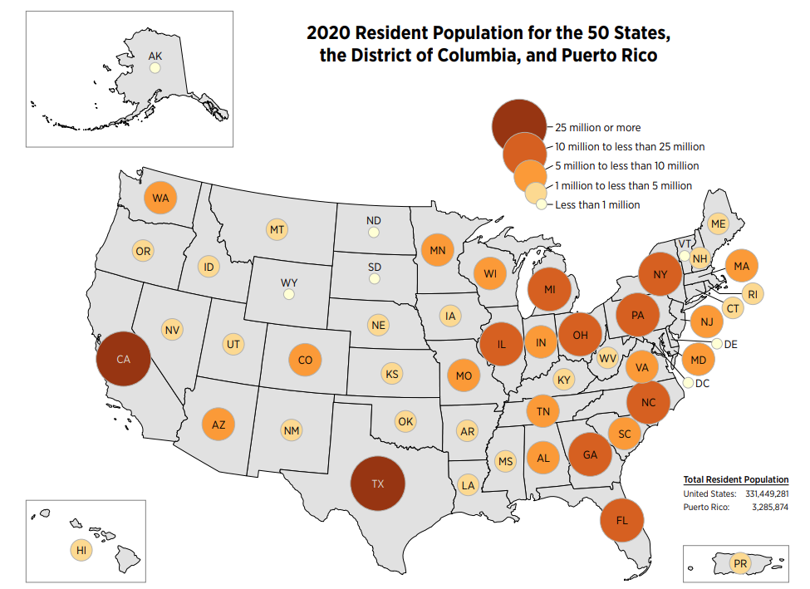

Examples for Image & Reasoning
Chart Understanding
According to the chart, is the combined population of South Carolina and Alabama greater or less than the population of Texas?
Text-rich Understanding
So what is the best strategy for the interview question in the image?

Slide 14
RQ II
How can we benchmark both individual and cross capabilities in LLMs?

Slide 15
CrossEval Benchmark
Overview: what does our benchmark include?
Setting
Single-turn, open-ended, expert-annotated prompts
1,400 prompts for 14 capabilities
Difficulty level
10% Easy, 30% Medium, 60% Hard
Multiple reference examples for each prompt (used for evaluation)
3 collected model responses (bad, medium, hard)
2 reviews for each model response
Human rating + explanation
Overall, 4,200 model responses and 8,400 human ratings with explanations

Slide 16
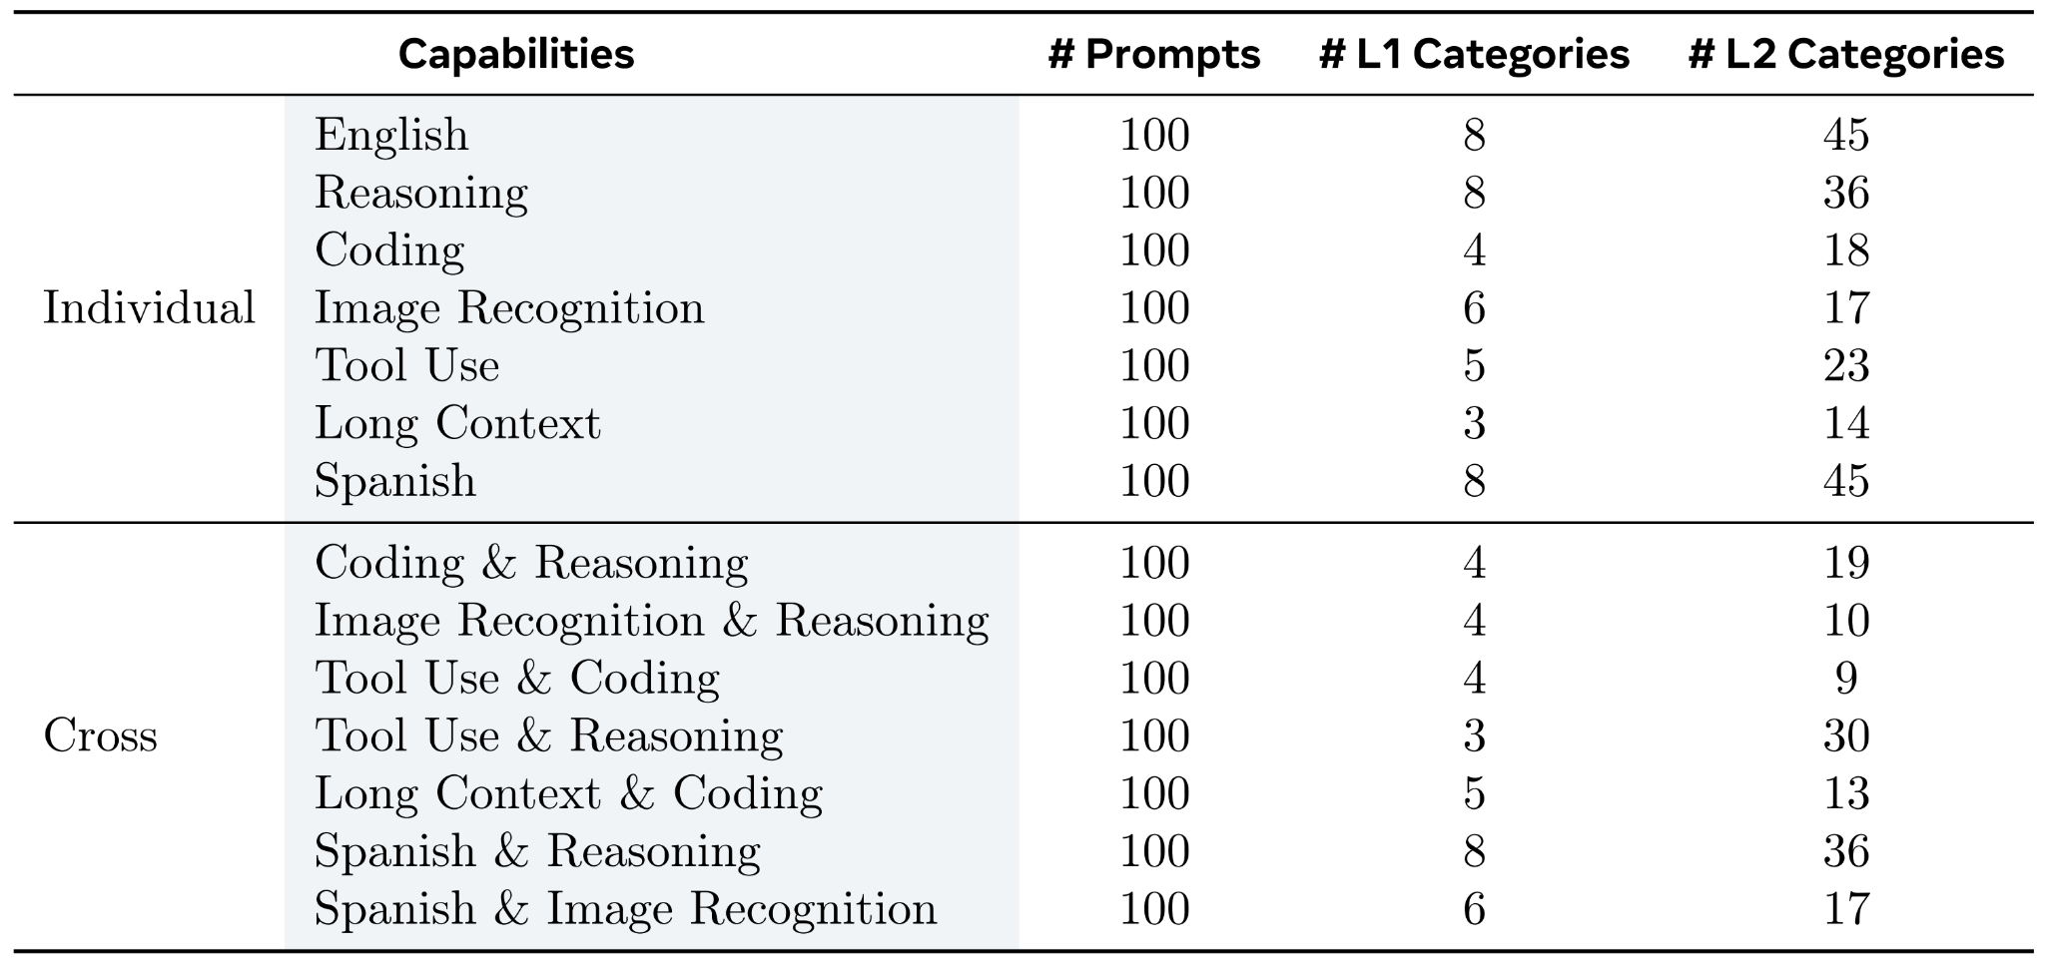
CrossEval Benchmark
Statistics for the prompts
100 prompts for each capability
76 Level-1 and 332 Level-2 categories

Slide 17
CrossEval Benchmark
Why not annotate ground truth for each prompt?
Many open-ended queries do not have a single correct answer
How do you predict the 2024 U.S. election?
Many prompts remain challenging even for college-level expert annotators
Olympiad-level math or coding problem
For prompts related to tool use, the correct response can be dynamic
What is the temperature in Champaign today?
Our solution
Reference examples specific to the current prompt for a more reliable LLM-as-a-Judge
Reference examples = 3 model responses + 6 human reviews

Slide 18
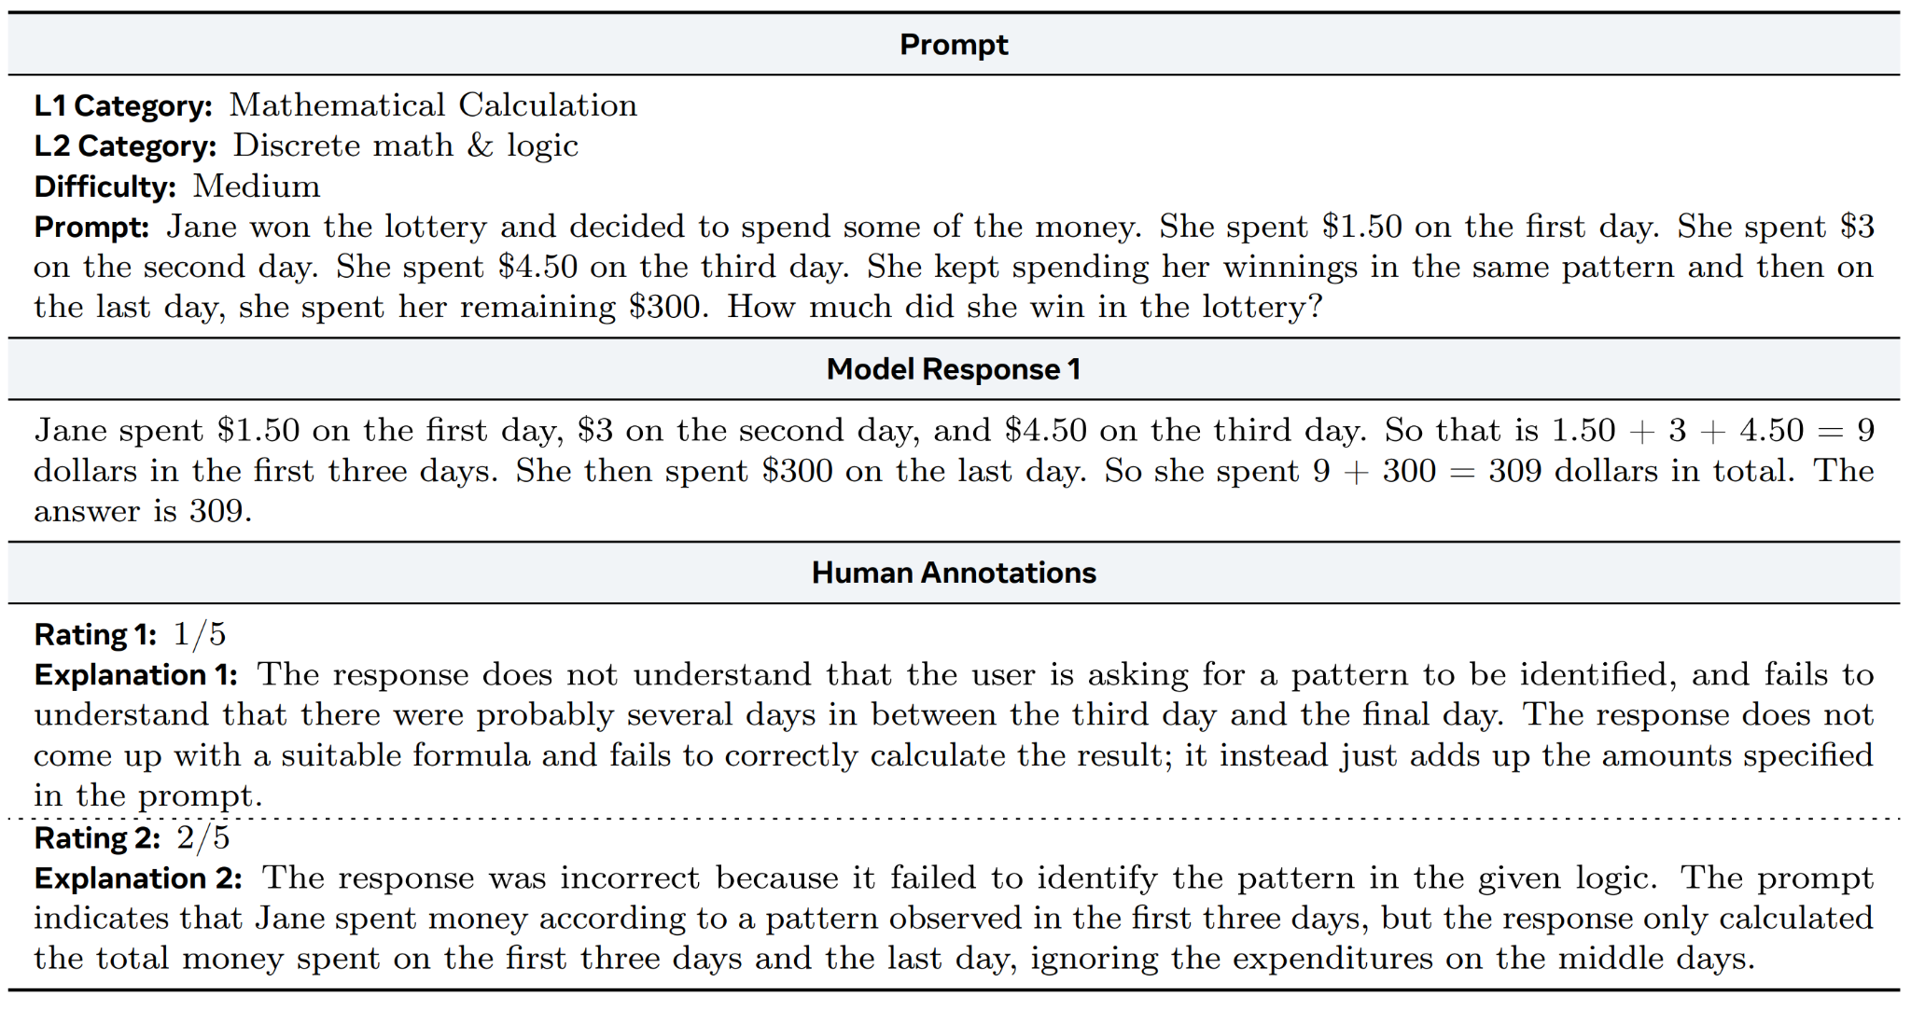
Reference Examples

Slide 19
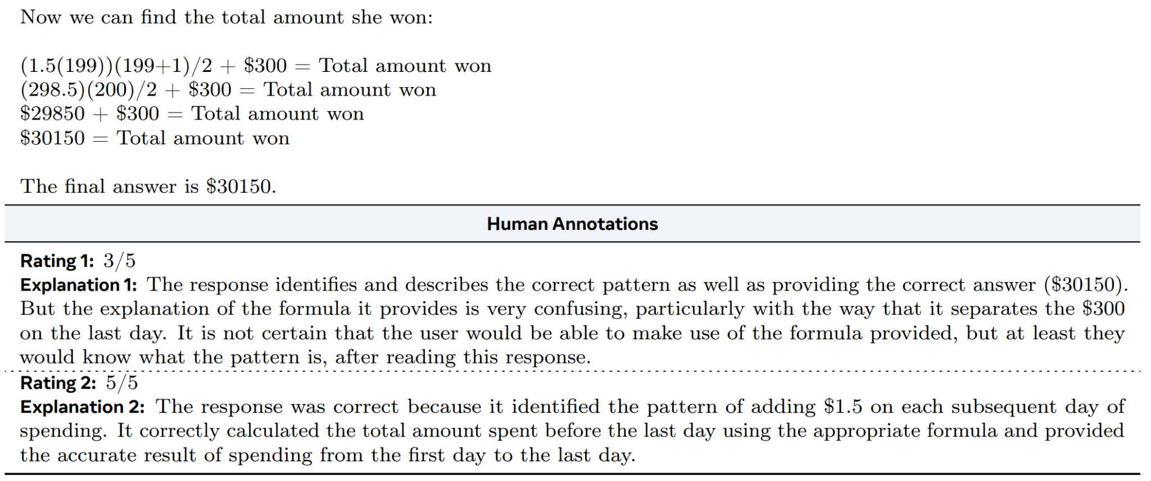
Reference Examples
…

Slide 20
Inter-Rater Agreement
Training Round on 30% Benchmark
Agreement Rate (1-5 scale)
33.7% → 45.8% → 47.4%
K-Alpha
0.48 → 0.66 → 0.73
Inter-Rater Agreement on Full Benchmark after Training
Agreement Rate (1-5 scale)
54.93%
K-Alpha
0.76 (strong agreement)

Slide 21
Prompting LLMs to Evaluate Open-Ended Responses
Previous Research Efforts
Issues with LLM-as-a-Judge
No reference, overly rely on the self-generated answer
No evaluation consistency
Tends to give higher scores, significantly above human ratings
Our Methods
Multi-reference-based Prompting
3 reference examples for each prompt
Point deduction-based Prompting
Summarize the typical point deductions from references
Apply them into model response evaluation

Slide 22
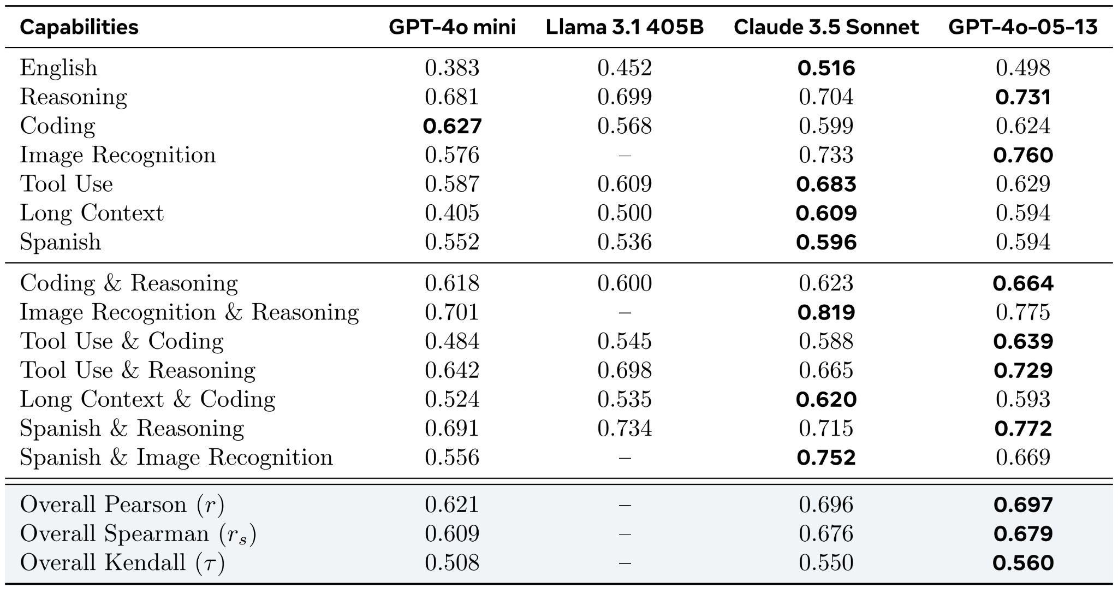
Correlations with Human Judgement
Each LLM shows particular strengths in evaluating different capabilities
Our methods can achieve nearly 0.7 Pearson correlations with expert judgements

Slide 23
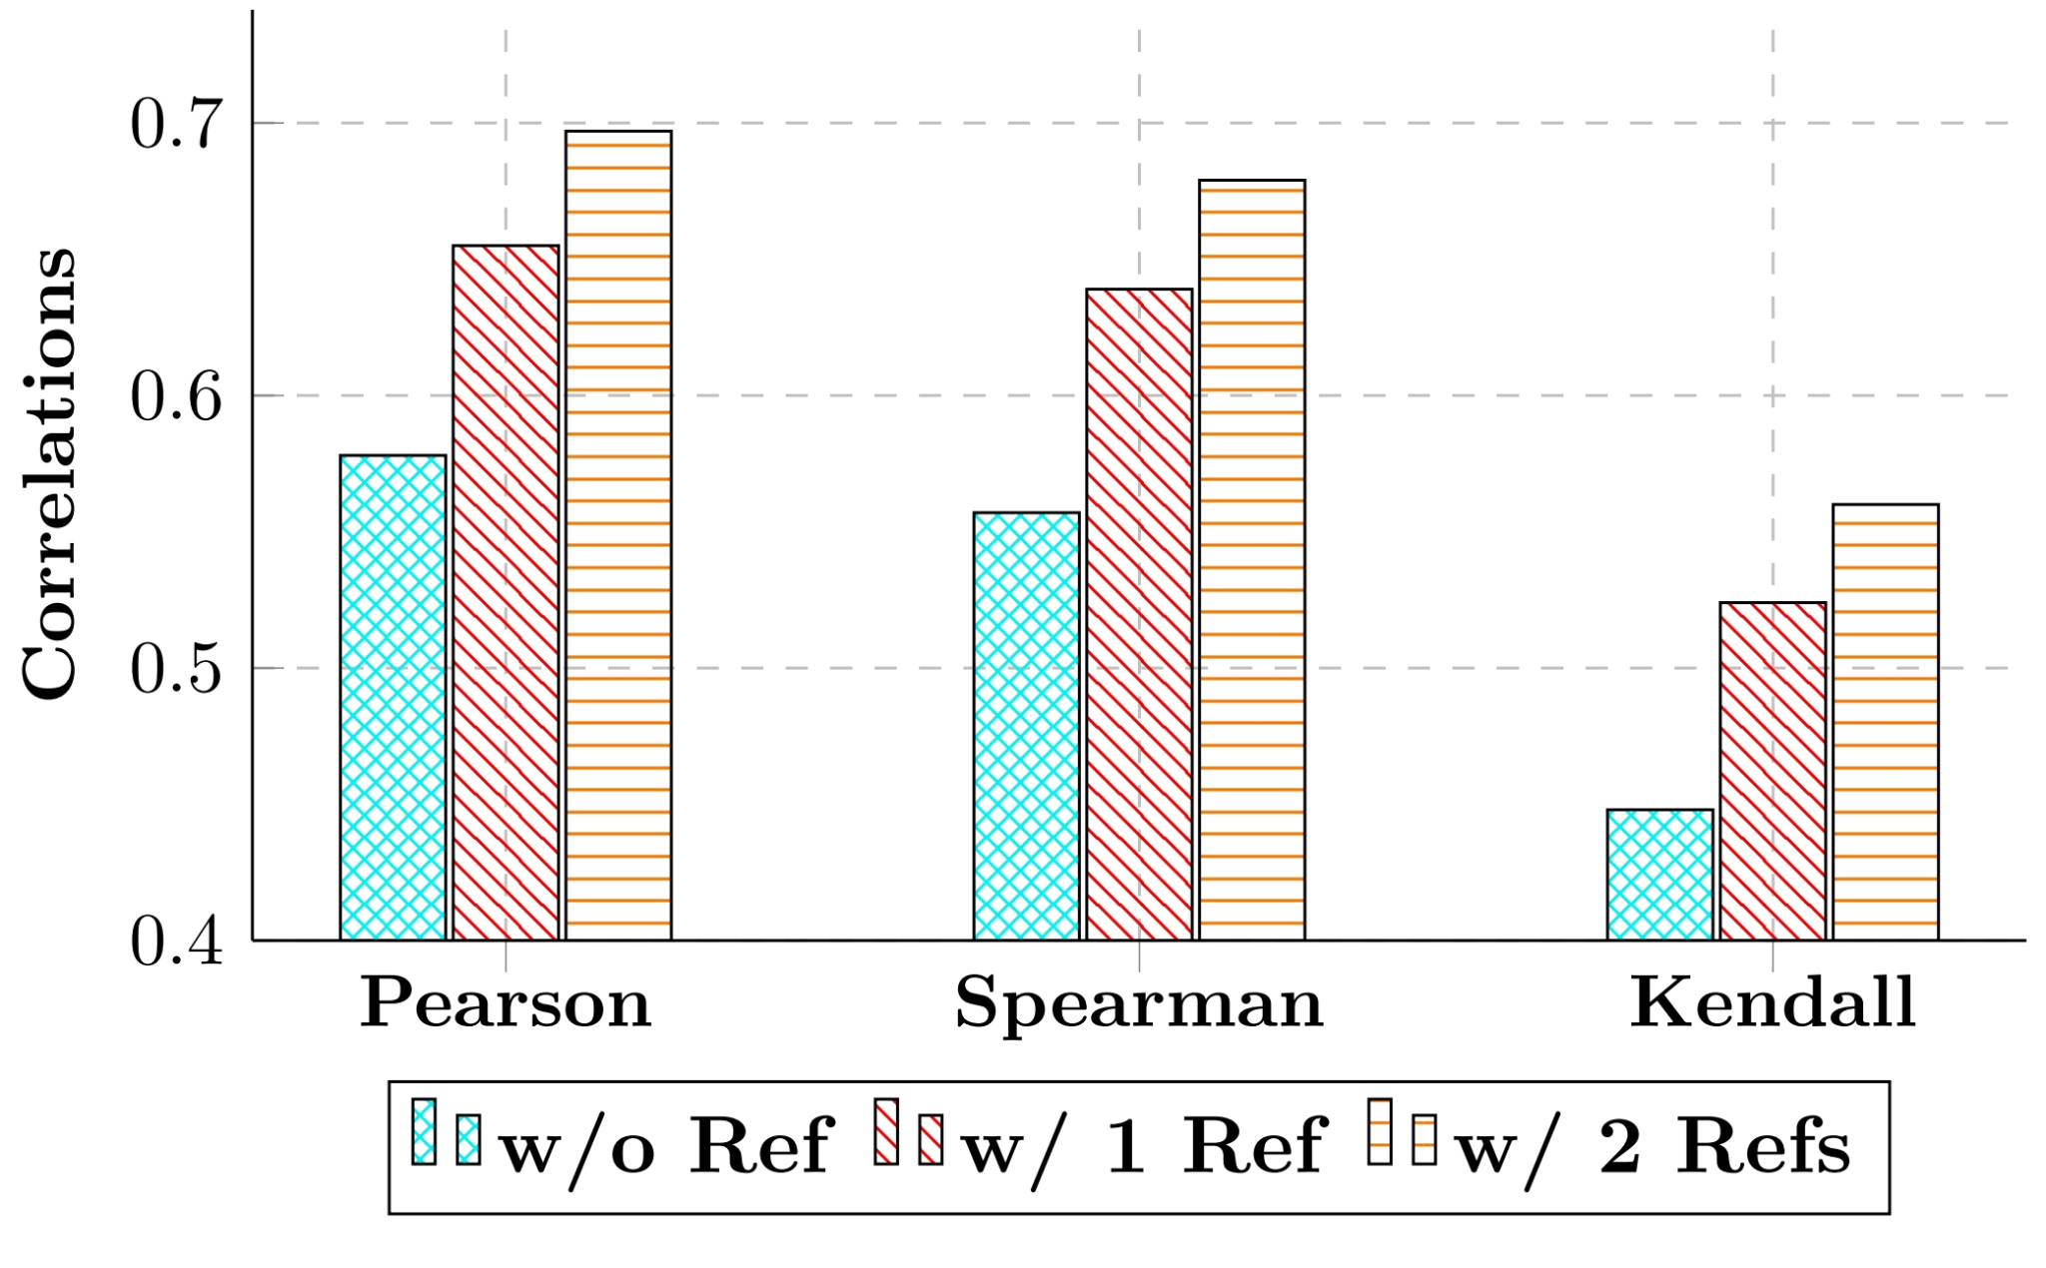
Ablation Study on the Reference Examples
More Reference Examples → Better Correlations

Slide 24
RQ III
What patterns exist in the relationship between individual and cross-capability performance in LLMs?

Slide 25

Potential Patterns
Synergy Theory?
Cross performance > all individual

Slide 26
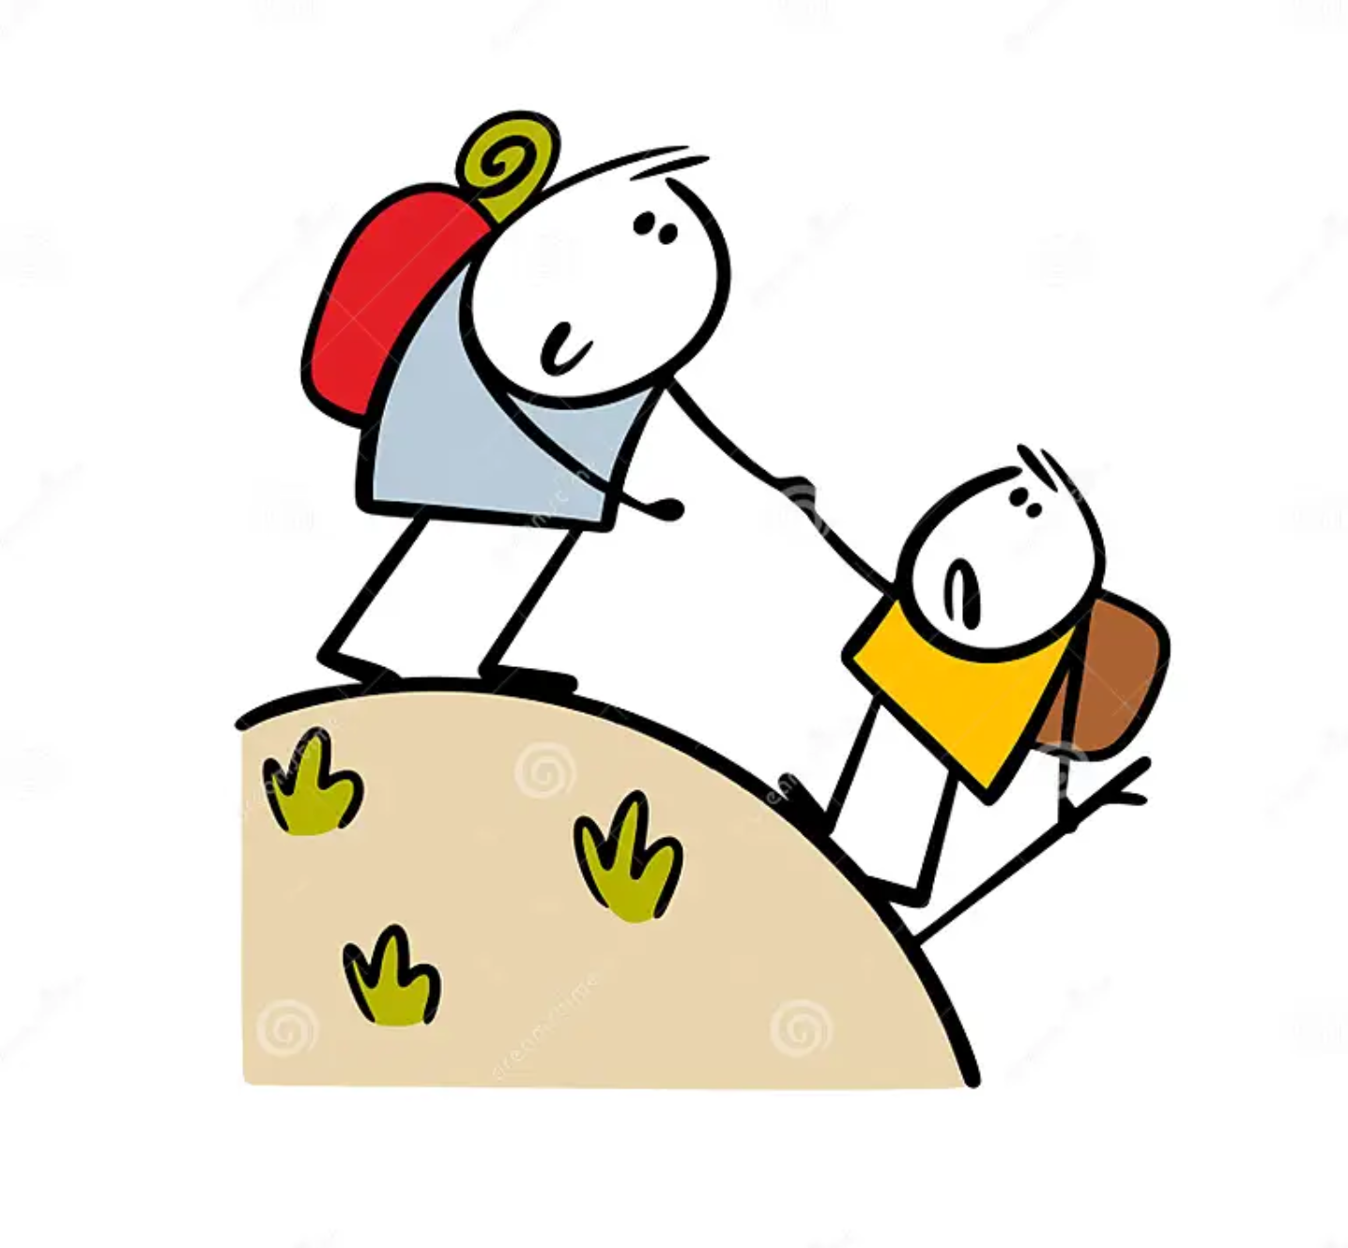
Potential Patterns
Synergy Theory?
Cross performance > all individual
Compensatory Mechanisms?
Stronger capabilities can compensate for weaker ones

Slide 27
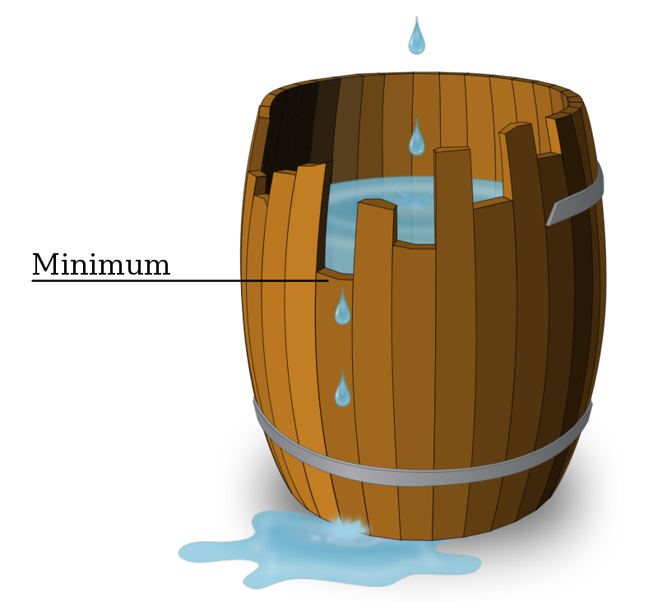
Potential Patterns
Synergy Theory?
Cross performance > all individual
Compensatory Mechanisms?
Stronger capabilities can compensate for weaker ones
Law of the Weakest Link?
Cross is limited by the weakest capability

Slide 28

Potential Patterns
Synergy Theory?
Cross performance > all individual
Compensatory Mechanisms?
Stronger capabilities can compensate for weaker ones
Law of the Weakest Link?
Cross is limited by the weakest capability
Emergent Properties?
Cross performance is unpredictable

Slide 29
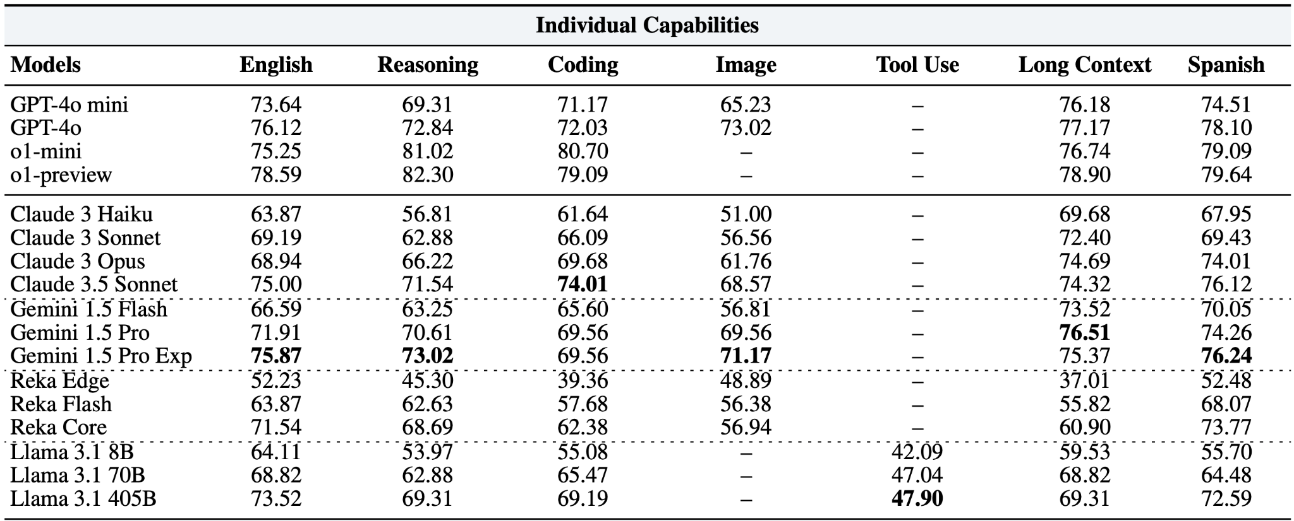
Results for Individual Capabilities
CrossEval effectively differentiates advanced models
Overall, Tool Use is the most challenging capability

Slide 30
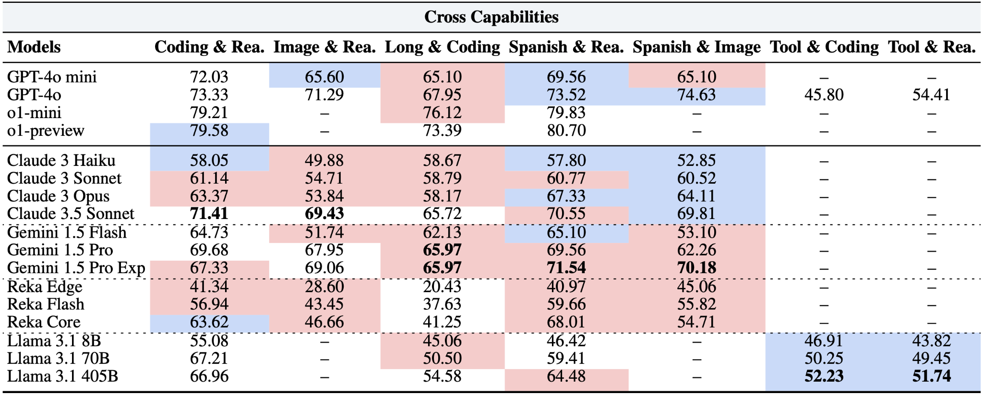
Results for Cross Capabilities
Lower than the weaker capability: 38/58
Between weak and strong, but closer to the weak: 20/58
Closer to or better than strong: 0/58

Slide 31
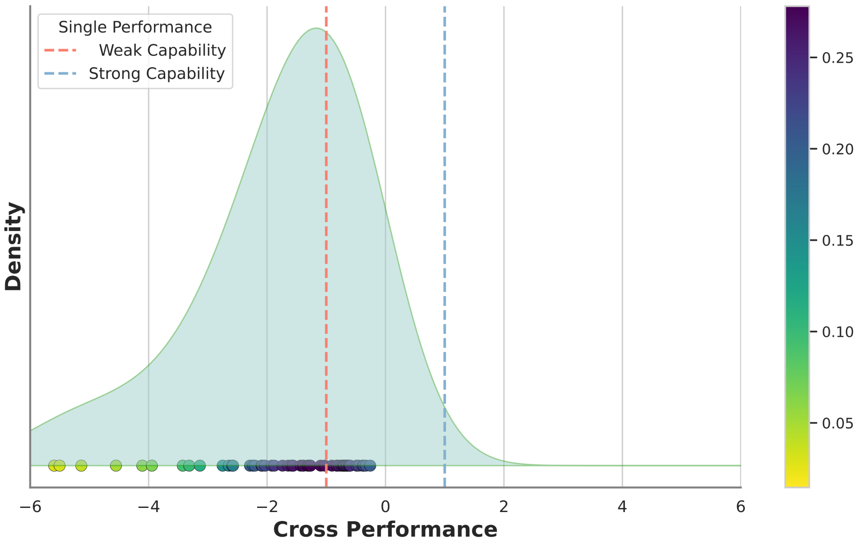
“Law of the Weakest Link” in LLMs
Remap weak to -1, strong to 1, plot the distribution of cross performance
Cross performance is significantly limited by (clusters around) the weak capability

Slide 32
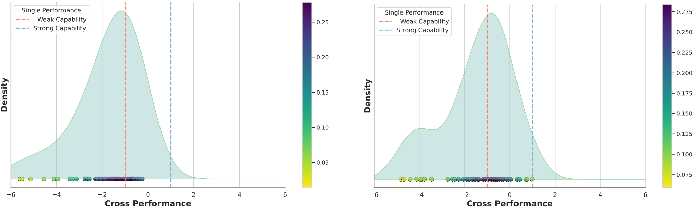
“Law of the Weakest Link” is Evaluator-Agnostic
Left: GPT-as-a-Judge
Right: Claude-as-a-Judge

Slide 33
RQ IV
How do performance shifts in individual capabilities impact cross performance?

Slide 34
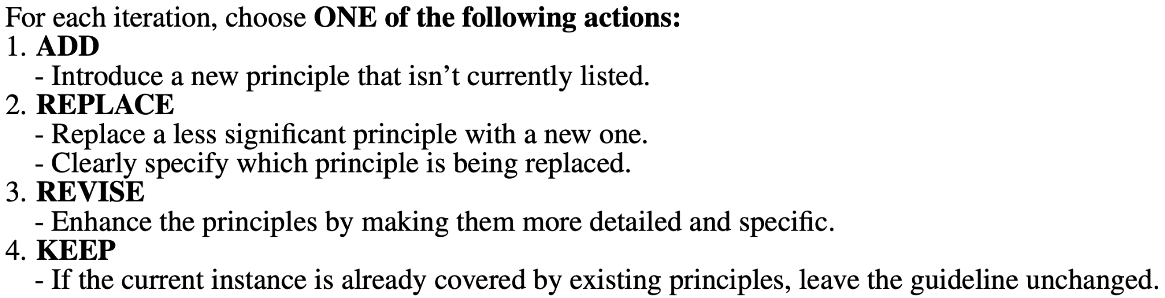
How to Enhance Specified Individual Capability?
Principle-based System Prompting
Learn from the error cases from the specified capability for the given model
Iteratively update the principles
Finally, 10 principles for each capability
Use the generated principles as the system prompt to instruct the model

Slide 35
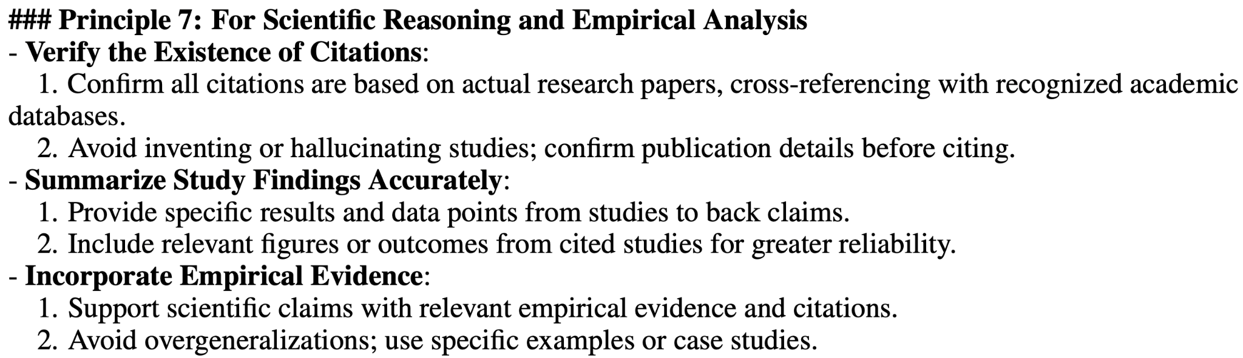
Case Study for the Generated Principles

Slide 36
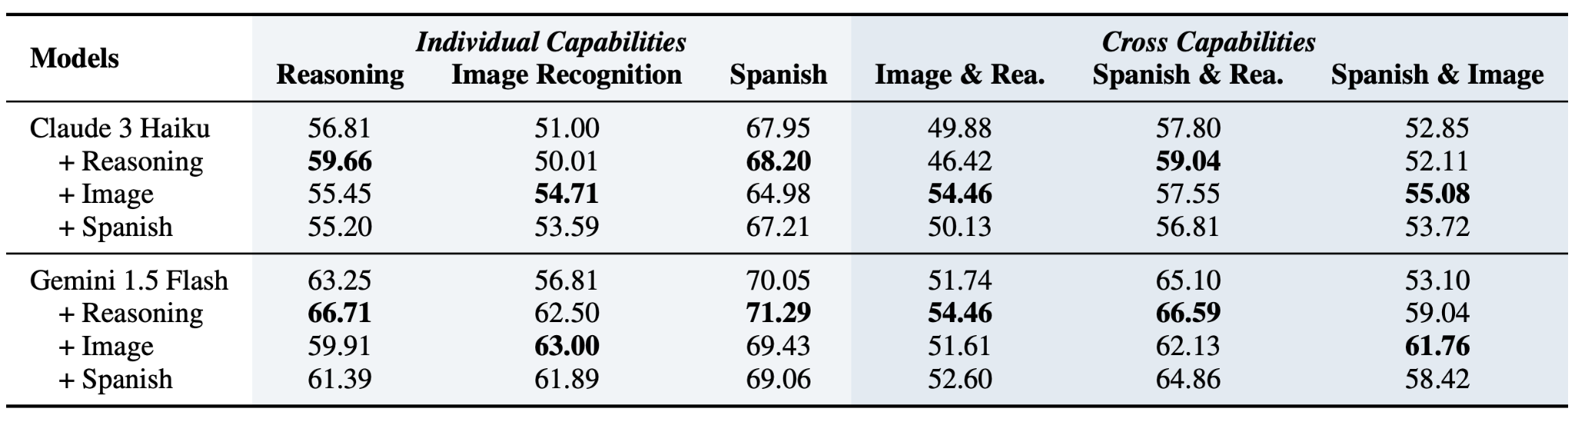
“Law of the Weakest Link” Persists after Enhancement
Take Image (weak) & Reasoning (strong) in Claude 3 as an example
Weak ↓ 0.99 + Strong ↑ 2.85 → Cross ↓ 3.46
Weak ↑ 3.71 + Strong ↓ 1.36 → Cross ↑ 4.58
90% changes in cross performance closely follow the trends of the weaker capability

Slide 37
Takeaways
Cross capability is the critical oversight of the development and evaluation of LLMs
New testbed for evaluating cross capability
New benchmark + new LLM-as-a-Judge framework
Identify “Law of the Weakest Link” in LLMs
For both static and dynamic evaluation
Implications
Capture and enhance the weakest capabilities should be a priority for future development
Standalone LLMs are insufficient for real-world tasks due to inevitable weak points

Slide 38
Thank You!

